Slide 1





























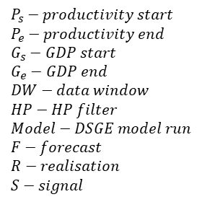
$$R_{3}$$
$$R_{n}$$
$$R_{2}$$
$$R_{1}$$
$${HP}_{1}$$
$${DW}_{3}^{G}$$
$${DW}_{n}^{G}$$
$${DW}_{2}^{G}$$
$${DW}_{1}^{G}$$
$$G_{s}$$
$$G_{e}$$
$$time (quarterly)$$
$$P_{s}$$
$$P_{e}$$
$$P_{s}−productivity start$$
$$P_{e}−productivity end$$
$$G_{s}−GDP start$$
$$G_{e}−GDP end$$
$$DW−data window$$
$$HP−HP filter$$
$$Model−DSGE model run$$
$$F−forecast$$
$$R−realisation$$
$$S−signal$$
$${DW}_{1}^{P}$$
$${DW}_{2}^{P}$$
$${DW}_{3}^{P}$$
$${DW}_{n}$$
$${HP}_{1}$$
$${Model}_{1}$$
$$F_{1}$$
$$ρ_{1}$$
$$e_{1}$$
$$F_{2}$$
$$F_{3}$$
$$F_{n}$$
$$S_{1}$$
$$S_{2}$$
$$S_{3}$$
$$S_{n}$$

